Slide 2
The War We Are In
We continue to live in the world of “Denial.”
Save Now-Pay Later Scheme
We are about to see a Beslan massacre in America!
What about Mumbai style attacks?...they’re coming!!!
How?...These terrorists are patient. They systematically & methodically plan their attack and if we as a country are NOT trained and prepared we will fall victim to their plot and become another gruesome statistic in the record book.
We MUST train, prepare and deter.

Slide 3
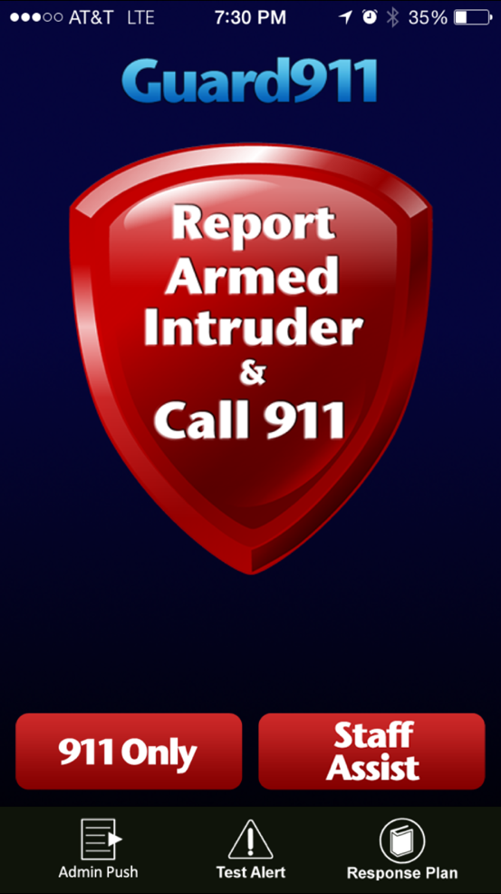
An Emergency Alert App for Approved Staff

Slide 4
School Shootings - United States
Average Number of Shooting Incidents Per Year
Workplace Shootings & Violence are Also on a Rise
55+
1.6
2.1
2.4
3.4
4.0
10.1
(2015)
1960s
1970s
1980s
1990s
2000s
2010s

Slide 5
Quick Facts:
2 Million
American workers report having been victims of workplace violence each year
397
270
Workplace Homicides
Workplace Suicides
80%
Homicides resulted from shootings
29,000+
Acts of rape or sexual assault are perpetrated against women at work each year
74%
of domestic violence victims are harassed at work

Slide 6
The Problem
The average workplace shooting lasts only
10 minutes
The average police response time to an active shooting is
17 minutes
Source: U.S. Department of Homeland Security

Slide 7
What happens when you call 911?
2
Call is routed to a centralized 911 call center.
3
Center might be overwhelmed with incoming calls.
(20% of 911 calls are abandoned)
1
4
The 911 operator has to interpret the emergency.
Dialing…
911
5
911 operator directs call to the appropriate agency.
6
Appropriate agency receives the information.
Emergency Call
7
Agency then dispatches the officers.
Officers must drop what they are doing and travel to the scene from their current location.
Help Arrives.
Average police response time is 17 minutes!
8

Slide 8
Dec 14 2012
Time Line Case Study Sandy Hook Elementary School
9:35:00 a.m. (0 Seconds)
Main office staff reports hearing glass breaking and seeing the shooter. 911 call is made.
9:44:47 a.m. (+587 Seconds)
9:39:00 a.m. (+240 Seconds)
Newtown officers enter Sandy Hook Elementary School.
First Newtown police officer arrives.
9:37:06 a.m. (+126 Seconds)
9:40:03 a.m. (+303 Seconds)
Newtown Police Department Dispatcher broadcasts shooting at Sandy Hook Elementary School.
Last gunshot is heard. Suicide shot from the shooter.
Notes:
Time Line Case Study
Sandy Hook Elementary School
December 14, 2012
(Have each of the bullets below display after each click)
(click) Approximately 9:35am (+ 0 Seconds) Main office staff reports hearing glass breaking and seeing the shooter. 911 call is made. (FassForward place click here to play this 911 audio)
(click) 9:36:06 (+126 Seconds) Newtown Police Department dispatcher broadcasts shooting at Sandy Hook Elementary School.
(click) 9:39:00 (+240 Seconds) First Newtown police officer arrives.
(click) 9:40:03 (+303 Seconds) Last gunshot is heard. Suicide shot from the shooter.
(click) 9:44:47 (+587 Seconds) Newtown officers enter Sandy Hook Elementary School.

Slide 9
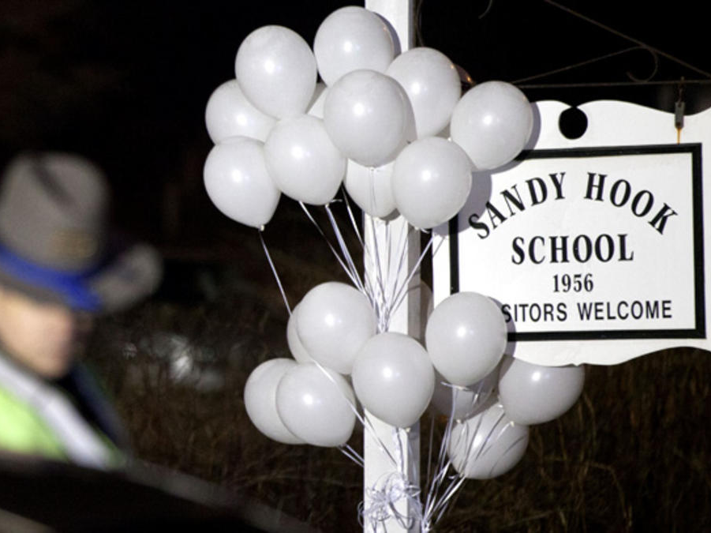
What Does This Teach Us?
Extremely fast response time.
Police were on scene within 4 minutes of the 911 call.
Shooter kills 20 students and 6 school staff members in 303 seconds.
That is one person every 11.65 seconds.
Guard911 could have alerted police 126 seconds sooner (11 lives sooner).
42% reduction in response time.
Notes:
What Does This Teach Us?
(click) Extremely fast response time. Police were on seen within 4 minutes of the 911 call.
(click) Shooter kills 20 students and 6 school staff members in 303 seconds. That is one person every 11.65 seconds.
(click) SchoolGuard could have alerted Newtown police 126 seconds sooner (11 lives sooner). Response time cut by 42%.
(click) How many more deaths would there have been if police response time was the average 18 minutes?
(at the bottom of this slide have the SchoolGuard When Seconds Save Lives graphic fade in. This is the graphic from slide 5 and remove slide 5 from deck)

Slide 11
Current Solutions
Hire an armed security officer?
Costly at a salary of $40,000-$60,000 /year.
Arm our staff with weapons?
Liability issues.
Thousands of dollars for training and certification mandates.
Brings the problem to work.
Provide police with digital maps?
Does not help the first responding officers who are trained to rush toward the sound of gunfire.

Slide 12
Install panic buttons?
Install Door locks and bulletproof windows?
Install video cameras?
Only speed dial 911.
Limited number because of the cost.
Need to be strategically placed and are not mobile.
False alarms.
Pre-smart phone & Pre-social networking solution.
These are delay tactics.
Must be monitored and then reported.
Have no impact on police response time.
Very expensive to install.
Capture the crime to later talk about.
Have no impact on police response time.
TruArmor.com
FANTASTIC product and partner of Guard911

Slide 13
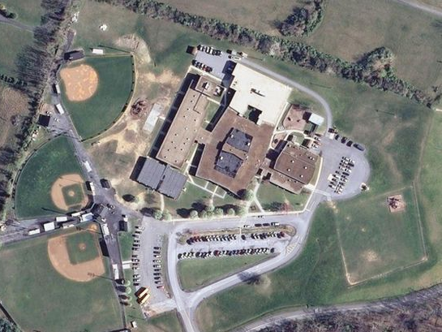
Is it working?
Sandy Hook Elementary was a “Hardened” target!
The second deadliest mass murder
at a U.S. elementary school.
“Hardened Target”
Security system with video cameras.
Visitors must be identified & buzzed in.
Bulletproof glass at entrance.
Doors locked after 9:30am.
Columbine had two armed security guards
and was the deadliest
shooting at a U.S. high school.

Slide 14
Police strategies have changed
Pre-Columbine
Post-Columbine
CONTAIN & WAIT STRATEGY
Set up perimeters (inner and outer).
Wait for specially trained elite police team (SWAT).
Try to negotiate and mitigate the situation.
ACTIVE SHOOTER TRAINING
Closest officers respond to take immediate action.
Enter the building and rush toward the sound of gunfire.
Take down the shooter as quickly as possible.

Slide 15
One Common Conclusion
During EVERY ONE of these senseless acts of violence studies show that a shorter police notification and subsequent response time can and WILL save lives.

Slide 16
Social Protection Network Next Generation Solution: Hero911 Network
Organize the 880,000 active federal, state, & local law enforcement officers (LEOs).
Enlist the 500,000 retired officers.
With annual certification and training to carry a weapon.
176,000 on-duty (20%)
704,000 off-duty (80%)
The goal is to increase the total number of responders:
784%
176,000 (on-duty LEOs)
increase in potential responders!
1,380,000 (all LEOs)

Slide 17
Wouldn’t it be infinitely better to have the first 1-2 LEOs on scene ASAP rather than the masses when it is all over…..when all the murders have taken place?

Slide 18
Rapid Adoption of Hero911 Network of Law Enforcement Officers
Hero911 app launched November 2013.
With over 1 million apps in the Apple App Store, Hero911 is the ONLY APPLE APPROVED app that creates a volunteer network of credentialed law enforcement officers.
All other similar app applications have been denied by Apple.
All information is encrypted and highly secure.
Does NOT track or store location information.
Notes:
With over 1 million apps in the Apple App Store, Hero911 is the only Apple approved app that creates a volunteer network of credentialed law enforcement officers. All other similar app applications have been denied by Apple.

Slide 19
Rapid Adoption of Hero911 Network of Law Enforcement Officers
Agents from over 25 Federal agencies:
FBI
DEA
ATF
US Secret Service
US Marshal Service
US Customs
US Border Patrol
US National Park Police
Homeland Security Investigations
And many others
Officers in all 50 states and growing fast:
State Troopers
Sheriff Deputies
City Police
Detectives
Campus Police
School Resource Officers
Other Specialized Police
To date there are well over 28,000 LEOs maintaining the Hero911 app.

Slide 20
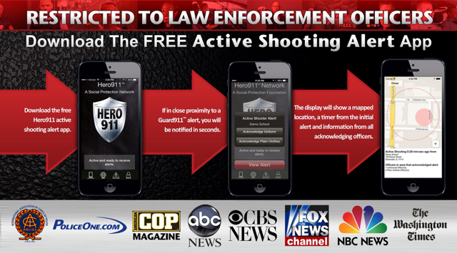
Ask your Law Enforcement to
download the FREE APP today

Slide 21
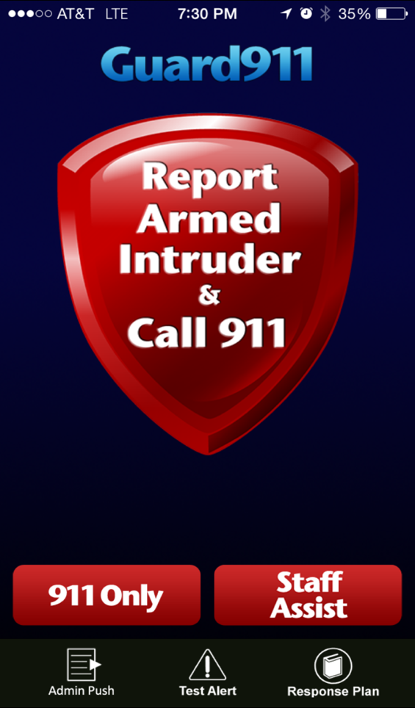
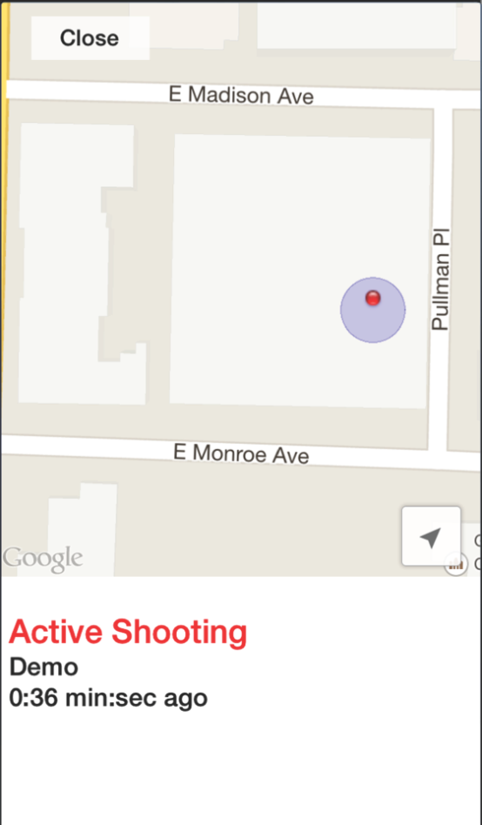
A Smartphone Application that puts a panic button in the hand of every staff member.
911
Speed dials 911.
Instantly alerts other staff.
Activates Hero911 Network
Maps the location of the alert.
&
Alerts all other Guard911
protected properties within 5 miles.
Mapping accuracy dependent on Cell/GPS signal strength
Notes:
When the main “Report School Shooting & Call 911” button is pressed play this sound file for 4 seconds then stop, - [alert.mp3]

Slide 22
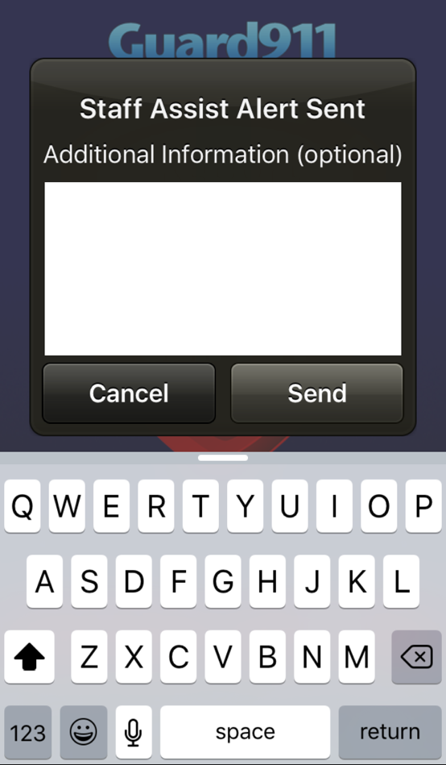
Staff Assist:
After the alert is immediately sent, a pop-up window allows the user to provide additional information.
F
I
G
H
T
I
N
L
O
B
B
Y
Send
T
Y
l
l
O
F
G
H
L
B
N

Slide 23
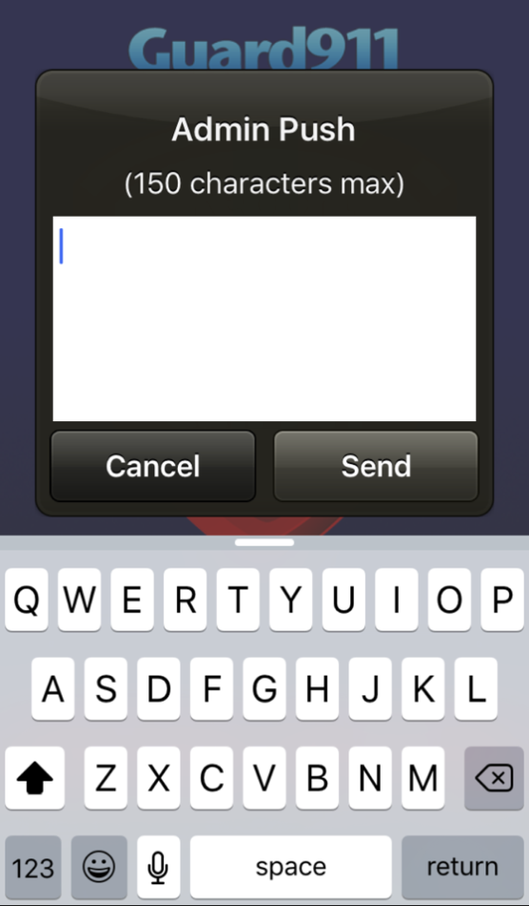
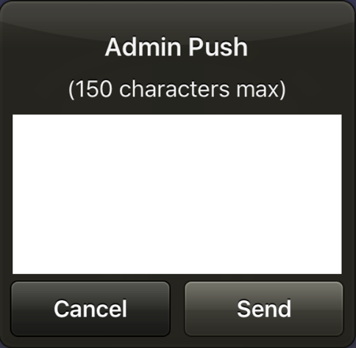
Admin Push:
The capability for the administrator to send a private message or warning to all Guard911 users.
P
O
W
E
R
O
U
T –
T
O
R
N
A
D
O
S
P
O
T
T
E
D –
E
X
E
R
C
I
S
E
E
M
E
R
G
E
N
C
Y
P
R
O
C
E
D
U
R
E
S
Send
W
E
E
E
E
E
E
E
E
E
E
R
R
R
R
R
R
T
T
T
T
Y
U
U
l
O
O
O
O
O
O
P
P
P
A
S
S
S
D
D
D
G
X
C
C
C
N
N
M
Notes:
After the principal push description is displayed add a click so the pop up box will show the following words being typed out on the screen and highlight one letter at a time in red as they are pressed to spell: power out - tornado spotted - exercise emergency procedures
Clear the pop up screen and add a click to spell out: Mr. Jones on school grounds. Release Johnny ONLY to MRS. JONES

Slide 24
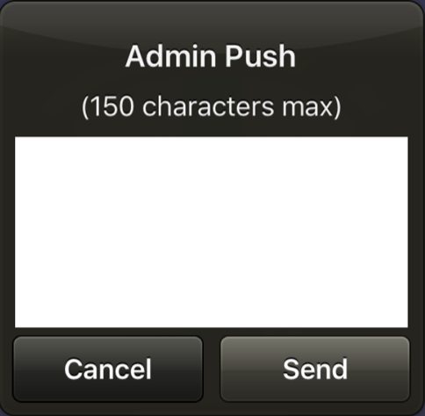
Admin Push:
The capability for the administrator to send a private message or warning to all Guard911 users.
A
N
G
R
Y
V
I
S
I
T
O
R
O
N
P
R
E
M
I
S
E
S.
P
O
L
I
C
E
E
N
R
O
U
T
E.
Send
E
R
T
Y
U
I
O
P
A
S
G
L
C
V
N
M
Notes:
After the principal push description is displayed add a click so the pop up box will show the following words being typed out on the screen and highlight one letter at a time in red as they are pressed to spell: power out - tornado spotted - exercise emergency procedures
Clear the pop up screen and add a click to spell out: Mr. Jones on school grounds. Release Johnny ONLY to MRS. JONES

Slide 25
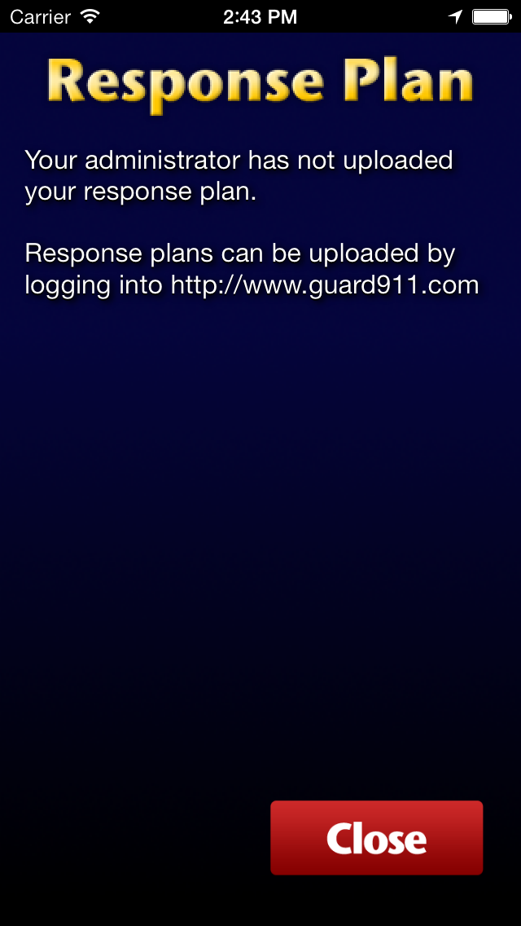
Response Plan:
Dedicated page for administration to upload the property's individual response plan.
Defaulted to the “I Love U Guys” foundation SRP for properties that are yet to develop one.

Slide 26
How it Works:
In a School Shooting

Slide 27
How it Works:
In Other Emergencies

Slide 28
Additional Features
Cost-effective solution less than a penny a day per employee
Alerts all other properties within 5 miles of the initial shooting emergency
Invisible solution to the employees so they can stay focused on work
Test Mode could be used to satisfy safety training mandates
Mobile solution with free unlimited downloads by staff and all free upgrades
Panic buttons only work on protected grounds in order to prevent false alarms

Slide 29
Guard911 Strategic Partners
Lt. Colonel Dave Grossman (Killology)
Lt. Brian Murphy (Sikh Temple massacre)
Safe2Safest.com (Strategic alliance)
John-Michael Keyes (“I Love U Guys” foundation)
Ron Borsch (National expert)
Ron Barber (In the Line of Duty)
Dr. Bobby Smith (Vision of Courage)

Slide 30
The World Today
“The world is a dangerous place to live; not because of the people who are evil, but because of the people who don’t do anything about it.”
Albert Einstein

Slide 31
Contact Information
Guard911, LLC
1 Regency Plaza Drive
Suite 120A
Collinsville, IL 62234
Nate McVicker President & Founder
nate@guard911.com
618.973.9174
Tom Swip Vice President & Chief Technical Officer
tom@guard911.com
618.974.9571

